Slide 1



Macrosystems EDDIE: Introduction to Ecological Forecasting
Moore, T. N., Lofton, M.E., Carey, C.C., Thomas, R. Q. 03 July 2023.
Macrosystems EDDIE: Introduction to Ecological Forecasting.
Macrosystems EDDIE Module 5, Version 2.
http://module5.macrosystemseddie.org
Module development supported by NSF DEB-1926050; NSF DBI-1933016
Notes:
Welcome the students to class.
It is important at this point to emphasize that there will be lots of new material covered during this module, and that going slowly and asking for help is very much encouraged!
If the students are using the Binder option for accessing the module, asking them to start loading the module in an internet browser will save time later (see link above)

Slide 2
Overview of today
Introducing the concepts of ecological forecasting, forecasting applications, and the iterative forecast cycle
Activity A: Get data from an ecological site and build an ecological model to simulate ecosystem productivity
Activity B: Generate and assess an ecological forecast
Activity C: Update model with new data and iteratively generate another forecast
Notes:
Quick road map of what will be covered in this lesson
Overview slide for the day (Will require instructor edits if adapting for different class lengths!)
2 classes (1:15 -1:30 in length), completion of Activity A in class 1 and Activities B and C in class 2; reports collected as homework; optional presentation of each groups results as time permits or in a 3rd class period
1 class (3:00 in length), Activity A - 45mins, 5min break, Activities B and C – 45 mins followed by presentation/discussion of each group’s results as time permits

Slide 3
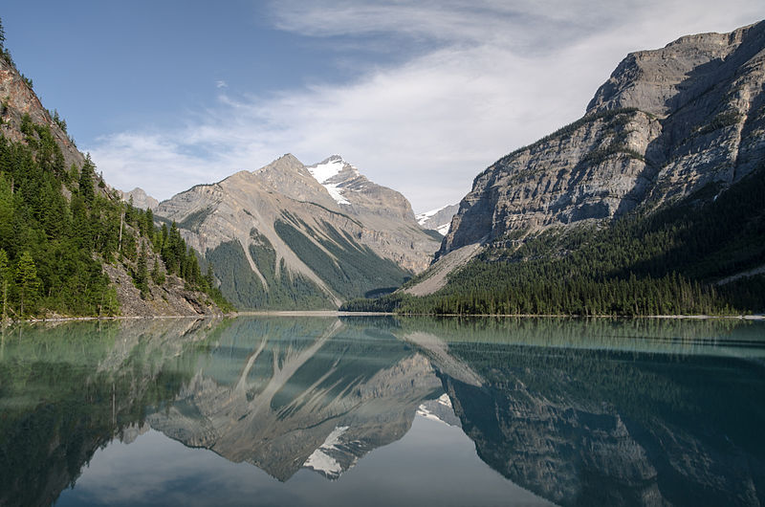
Ecosystems are changing worldwide…
In response to changes in climate and land use, aquatic and terrestrial systems are experiencing pressures which affect primary productivity
Lakes and reservoirs are key providers of ecological services and understanding how they will change in the short-term is critical to help manage these resources
Ecological forecasting is a potentially powerful tool to help lake and reservoir managers preemptively prevent or mitigate water quality concerns
Image: Wikimedia commons
Notes:
Big picture, framing ecological forecasts in the context of changing climate and land use.
Focus on aquatic ecosystems today, management of these resources could be improved by having advance knowledge of how they could potentially change.
Why do we want to generate ecological forecasts?
Answer: Because there is lots of variability in how climate change is occurring globally and lakes provide critical ecosystem services for humans, so ecological forecasts are critical to help management of these resources in the short-term.

Slide 4
Before we start:
What is a Forecast?
“A forecast is a prediction of a future event with uncertainty”
Events have not yet occurred
Gives a probability or a likelihood of the event to occur (uncertainty)
Actionable
Notes:
Ask the class “What is a Forecast?” –
if teaching virtually, prompt them to either type answers into the chat or raise their hand to ask the question.
Key aspects of a forecasts are listed in the slide.
Actionable implies that the information is given in a time frame that allows for a response. For example, you could forecast air temperature five minutes into the future with relatively low uncertainty, but this is not much use compared to a forecast for air temperature five days into the future.

Slide 5
Before we start
What do we Forecast?
Weather
Floods
Hurricanes
Forest fires
Economy
Disease transmission
Election results
Greenhouse gas emissions
Earthquakes
Land use
Player and team performance in sports
Sales
Transport planning
and much more!
Notes:
Ask the class ‘What do we forecast?’.
Encourage them to provide answers by either un-muting or typing into the chat or raising their hand.
Add the examples with the animation and detail how forecasting is prevalent across many different sectors of society.

Slide 6
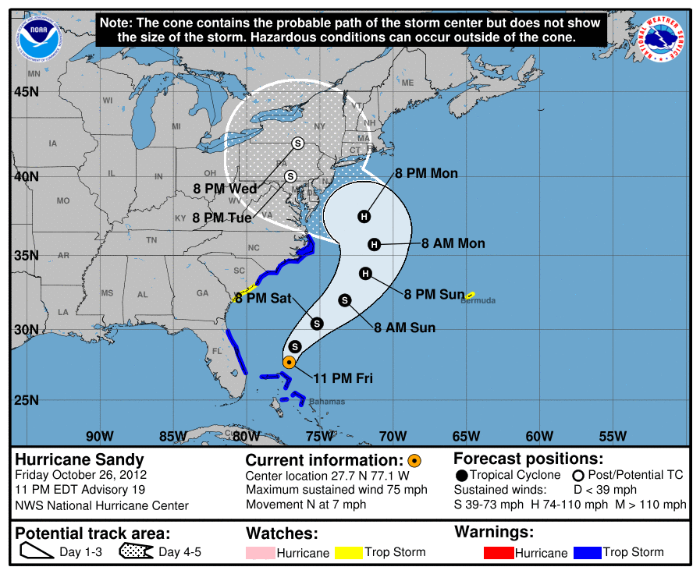
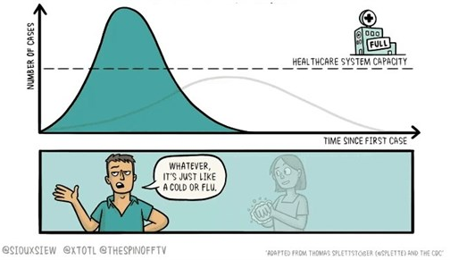
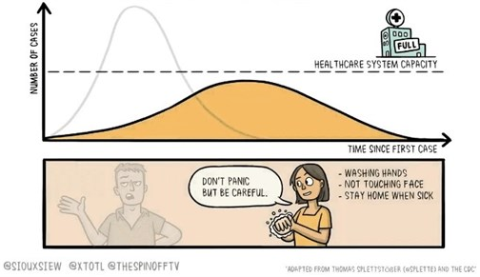
What is the purpose of a forecast?
Preparation
e.g. weather forecast - hurricanes
Action
e.g. disease forecasting, fire forecasts
Notes:
There are two main purposes of forecasts.
Talk through the examples and stress the difference between a situation when we have no control over the outcome (passive) and when we can influence the outcome (active)
Preparation – the example is Hurricane Sandy in 2012 - passive
Actionable – the example is COVID-19 - active

Slide 7
Our focal question:
What is an Ecological Forecast?
“Prediction of future environmental conditions
with uncertainty”
Notes:
Today, we are going to focus specifically on ecological forecasting.
Question to ask the students on this slide: what is an ecological forecast?
Highlight the inclusion of “uncertainty”

Slide 8
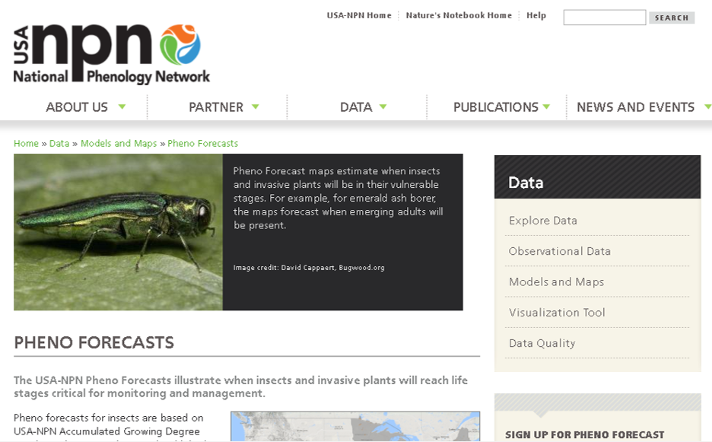
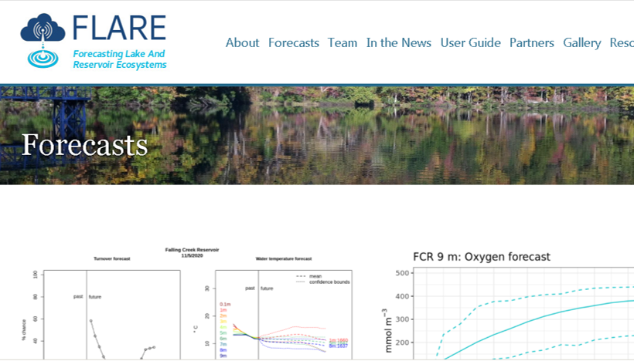
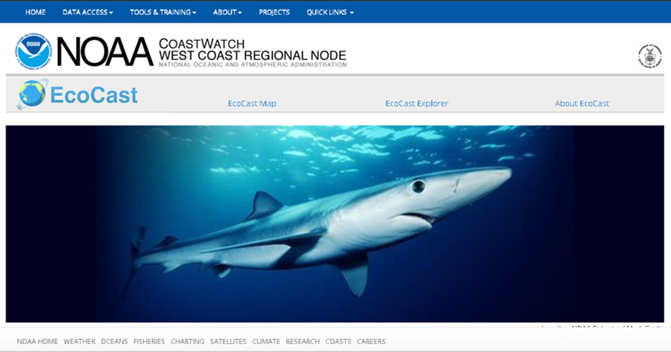
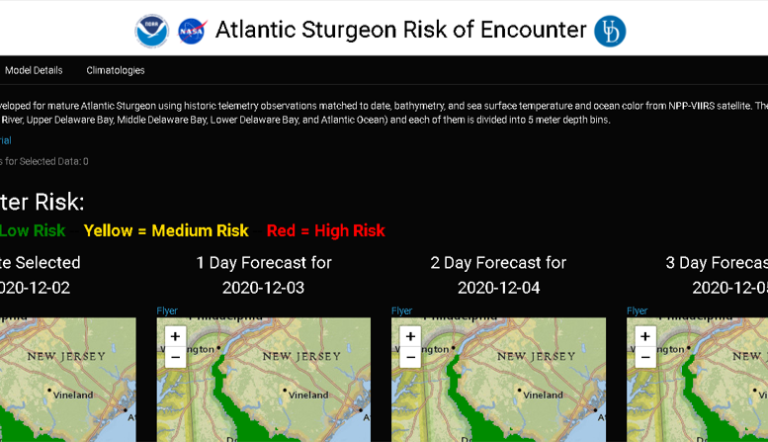
Ecological Forecast Examples
Short-term forecasts of phenological events in plants and pest insects.
Short-term forecasts of reservoir water quality for management of drinking water supply
Optimizing sustainable harvests of target fish while minimizing bycatch
Risk of encountering Atlantic Sturgeon in Chesapeake Bay
Notes:
Ecological forecasts are being produced today! These examples are selected from the pre-class “Exploration” activity that students may have completed. You might ask students, “Who do you think might use these forecasts, and why?”

Slide 9



?
?
Quantify Uncertainty
Generate
Forecast
The Forecast Cycle
Build Model
Communicate Forecast
?
Create
Hypothesis
Assess Forecast
Update Model
Notes:
Introduce the forecast cycle and that you will define each step. Highlight that it is “iterative” which means that it is a repetitive process, hence why it is described as a cycle.

Slide 10
?
?
Quantify Uncertainty
Generate
Forecast
The Forecast Cycle
Hypothesis: a proposed explanation of a phenomenon observed in the natural world
We might hypothesize: “More nutrients will increase the algal biomass in a lake.”
Build Model
Communicate Forecast
?
?
Create
Hypothesis
Create
Hypothesis
Assess Forecast
Update Model
Notes:
We will begin with creating a hypothesis, which is a proposed explanation for a phenomenon observed in the real world. For example, we might hypothesize that “More nutrients will increase the algal biomass in a lake.” You might ask students to provide additional examples of ecological hypotheses.

Slide 11

?
?
Hypotheses can be represented in mathematical models
We could write a model that says:
$${phyto}_{t} ={phyto}_{t−1}+growth −mortality$$
where growth is:
$$growth=Rgrowth ∗ {nutrients}_{t−1}∗{phyto}_{t−1}$$
Quantify Uncertainty
Generate
Forecast
The Forecast Cycle
Amount of phytoplankton today
Amount of phytoplankton yesterday
Nutrient
uptake
Phytoplankton death
Build Model
Build Model
Communicate Forecast
?
Growth rate
Nutrient concentrations yesterday
Amount of phytoplankton yesterday
Create
Hypothesis
Assess Forecast
Update Model
Notes:
Next, we can build our hypothesis into a mathematical model. For example, here we have built our hypotheses about nutrients and phytoplankton into a very simple model, which says that the amount of phytoplankton in a lake today depends on the amount of phytoplankton yesterday, plus the amount of growth due to nutrient uptake, minus death. Growth, in turn, depends on the phytoplankton growth rate (this is a parameter) times the amount of nutrients available yesterday and the amount of phytoplankton yesterday. Emphasize that the amount of growth will depend on the amount of available nutrients, and this is how the hypothesis is built into the model.

Slide 12
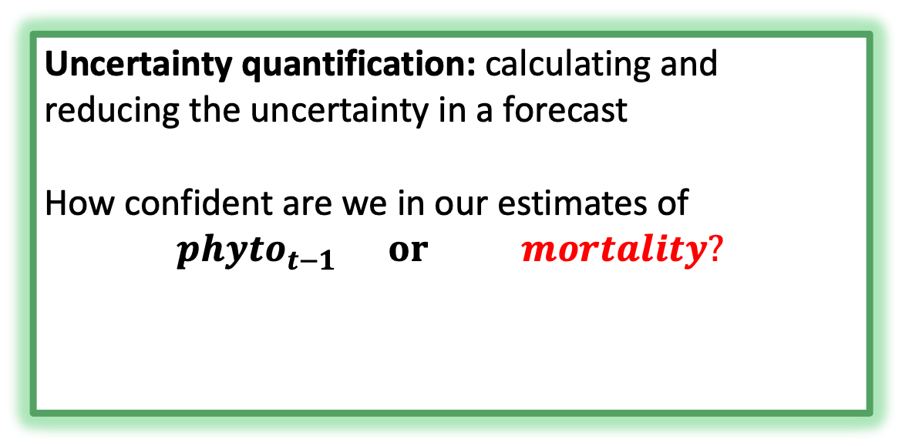
?
?
?
?
Quantify Uncertainty
Generate
Forecast
Quantify Uncertainty
Uncertainty quantification: calculating and reducing the uncertainty in a forecast
How confident are we in our estimates of
$${phyto}_{t−1} or mortality?$$
The Forecast Cycle
Build Model
Communicate Forecast
?
Amount of Phytoplankton yesterday
Phytoplankton death
Create
Hypothesis
Assess Forecast
Update Model
Notes:
Before generating a forecast, we should quantify the uncertainty associated with our forecast. Calculating the uncertainty associated with a forecast is critical to help forecast users make decisions based on forecast output. For example, how confident are we in our estimates of the amount of phytoplankton present yesterday or phytoplankton mortality? You will learn more about how to quantify uncertainty as you progress through the module.

Slide 13
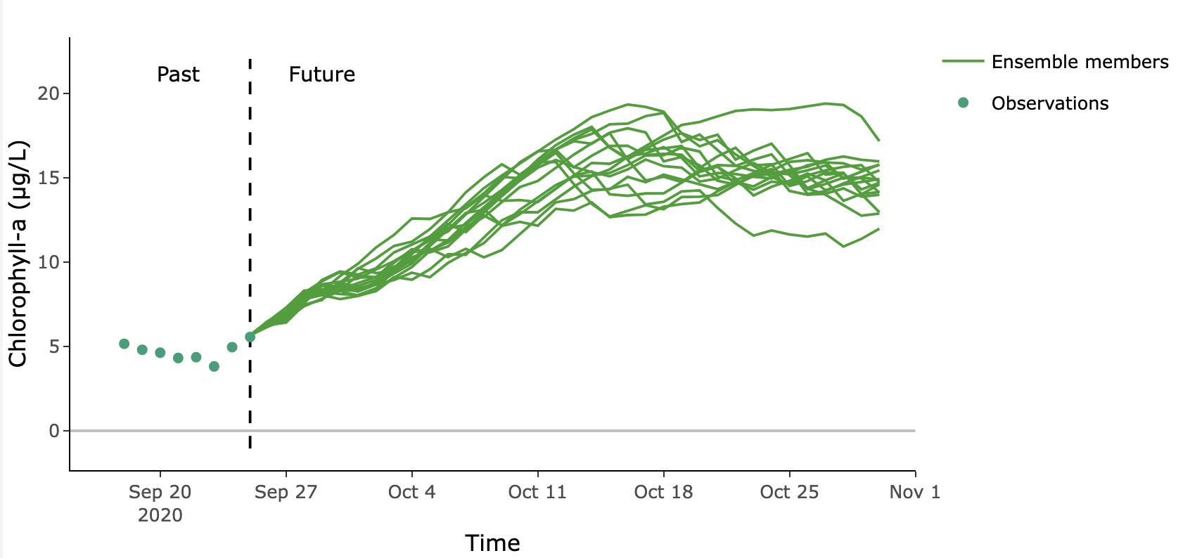
?
?
Quantify Uncertainty
Generate
Forecast
Generate
Forecast
We can run our mathematical model, with uncertainty, to create and plot a forecast.
The Forecast Cycle
Build Model
Communicate Forecast
?
Create
Hypothesis
Assess Forecast
Update Model
Notes:
Finally, we can run our mathematical model, with uncertainty, to create a forecast. The different lines here represent different runs of the model under different conditions. We call these different model runs “ensemble members”. The ensemble allows us to quantify our uncertainty.

Slide 14
?
?
Quantify Uncertainty
Generate
Forecast
The Forecast Cycle
Build Model
Good forecast communication may require us to translate a forecast into a different visualization for an end user.
Communicate Forecast
Communicate Forecast
Low risk of algal bloom tomorrow
?
Create
Hypothesis
Assess Forecast
Update Model
Notes:
After generating a forecast, we communicate our forecast to end users. Good forecast communication may require us to translate a forecast into a different visualization for an end user. For example, here the original forecast plot is translated into a stoplight graphic to more quickly communicate the risk of an algal bloom occurring tomorrow.

Slide 15
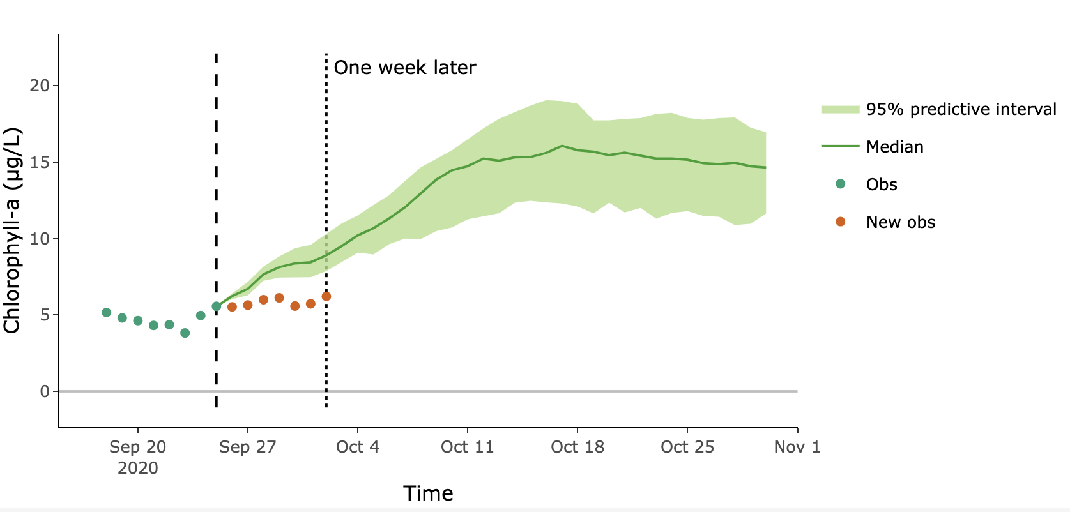
?
How closely did our forecast match observations?
?
Quantify Uncertainty
Generate
Forecast
The Forecast Cycle
Build Model
Communicate Forecast
?
Create
Hypothesis
Assess Forecast
Assess Forecast
Update Model
Notes:
The next step is to wait until the future arrives and then assess our forecast. Here, I am showing the example forecast we generated, but layered on top of it is an additional week of observations, which occurred after the forecast was generated. We can use these new observations, plotted in red, to assess the performance of our forecast.

Slide 16
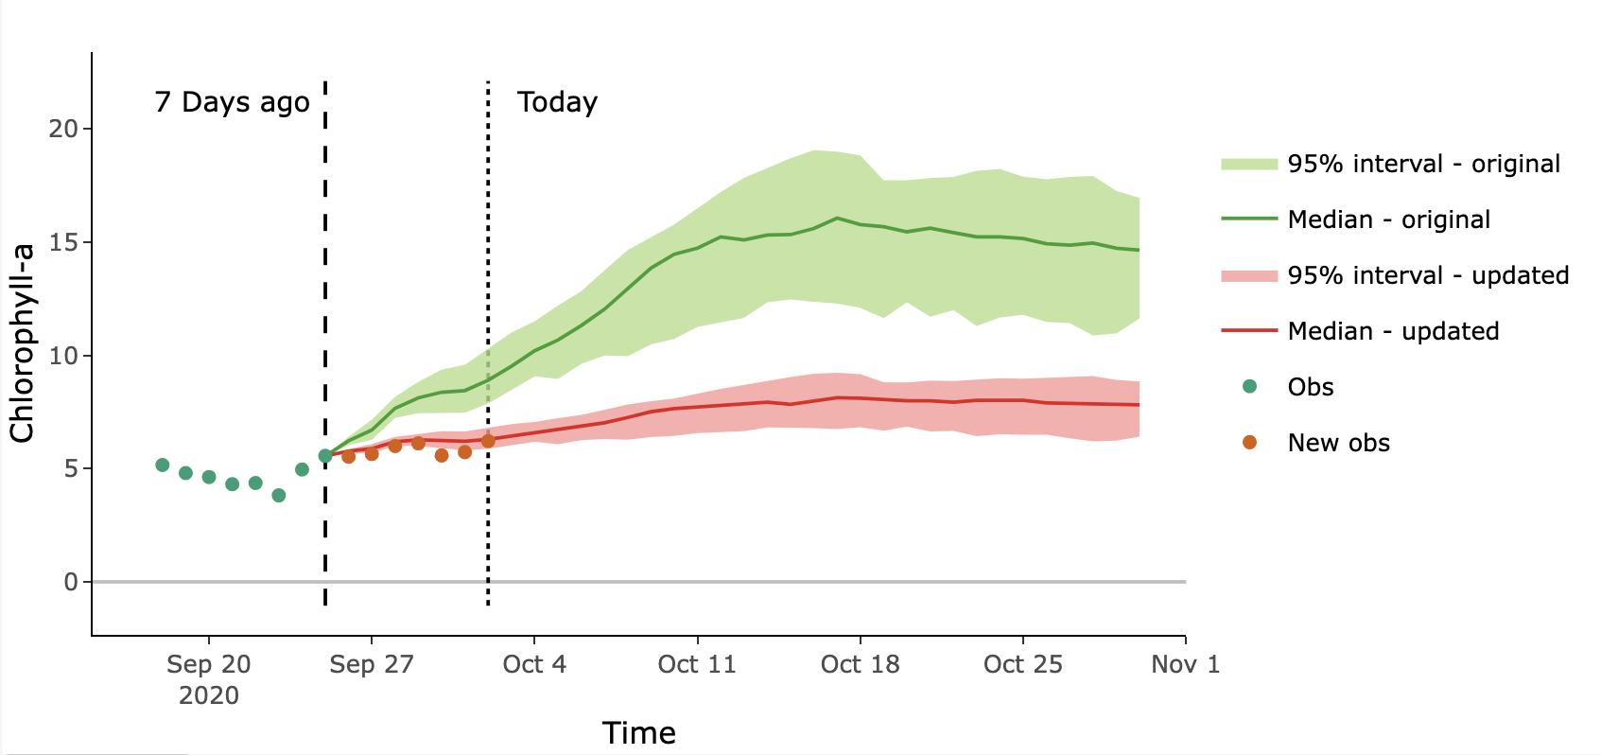
?
?
Quantify Uncertainty
Generate
Forecast
The Forecast Cycle
Here, we have updated model parameters to better match the most recent observations.
Build Model
Communicate Forecast
?
Create
Hypothesis
Assess Forecast
Update Model
Update Model
Notes:
After assessing our forecast, we can update our model to try to improve it for the next forecast. Here is the same plot shown on the previous slides, but the model has been updated with new parameter values to try to make it better match recent observations, and a “re-forecast” has been generated with the new parameters. The original forecast is shown in green and the reforecast is shown in red. The hope is that by updating the model, we can improve the performance of the next forecast, continuing the forecast cycle.

Slide 17
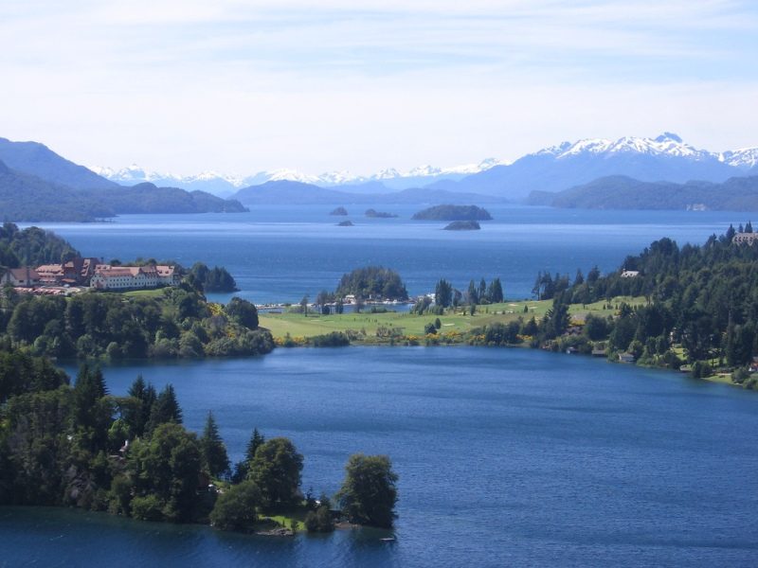
Today…
We are going to generate forecasts of primary productivity in lakes using an ecological model calibrated to real data from the National Ecological Observatory Network.
Primary productivity is the rate at which energy is converted into biomass by producers
What are the drivers of primary productivity in a lake?
Light
Water temperature
Available nutrients
Phytoplankton
Zooplankton
Image: Wikimedia commons
Notes:
Today, we are going to generate forecasts of primary productivity in lakes using an ecological model calibrated to real data from the National Ecological Observatory Network.
Primary productivity is the rate at which energy is converted into biomass by producers.
Ask the class, what are some of the drivers of primary productivity in a lake?
Answer: light, water temperature, available nutrients, phytoplankton, zooplankton, among others

Slide 18
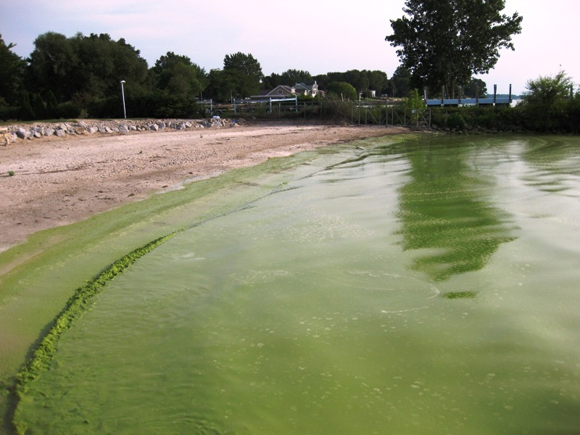
Today…
We are going to generate forecasts of primary productivity in lakes using an ecological model calibrated to real data from the National Ecological Observatory Network.
Why forecast primary productivity in lakes?
Excess primary productivity can lead to harmful algal blooms, which compromise water quality through:
Production of toxins,
Production of taste and odor compounds,
Creation of anoxic zones, leading to fish kills
Image: Wikimedia commons
Notes:
Why forecast primary productivity?
Excess primary productivity can lead to harmful algal blooms, which compromise water quality through:
a. Production of toxins,
b. Production of taste and odor compounds,
c. Creation of anoxic zones, leading to fish kills
Pre-emptive notice of a possible harmful algal bloom via an ecological forecast could allow managers to prevent or mitigate these adverse water quality impacts.

Slide 19


Today…
We are going to generate forecasts of primary productivity in lakes using an ecological model calibrated to real data from the National Ecological Observatory Network.
An ecological model is a simplified representation of nature, with the goal of understanding and predicting environmental dynamics
y = mx + b
Predicting chlorophyll-a concentrations in a lake
y
t
Notes:
We will use ecological models to generate our forecasts
An ecological model is a simplified representation of nature, with the goal of understanding and predicting environmental dynamics
A simple version of a model is a linear model: “y = mx + b”, but today we will be using a model to predict chlorophyll-a concentrations in a lake, where chlorophyll is the "y" in the equation but will add in other drivers such as surface water temperature and incoming light.

Slide 20


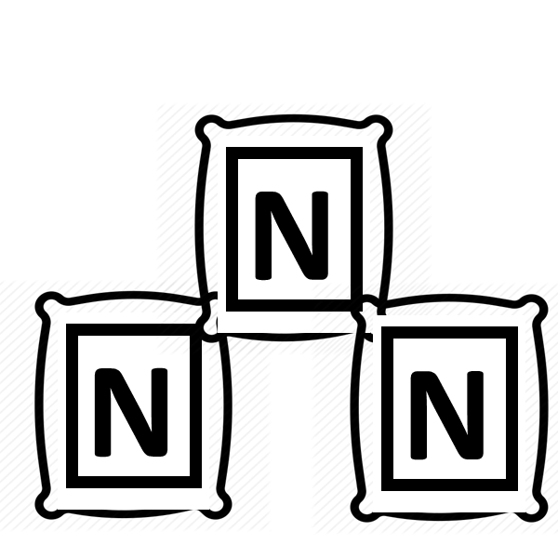

Today…
We are going to generate forecasts of primary productivity in lakes using an ecological model calibrated to real data from the National Ecological Observatory Network.
Water temperature
Light
growth
Producer
Nutrients
Phytoplankton
Nitrogen
mortality
Notes:
Today, we will use a simple primary productivity model, where phytoplankton are the producers which determine the rate of primary productivity. Phytoplankton grow by taking up nutrients, in this case nitrogen, and also die, releasing nutrients back into the water column. The rate of phytoplankton growth is also affected by the water temperature and the amount of incoming light, which phytoplankton need for photosynthesis.

Slide 21
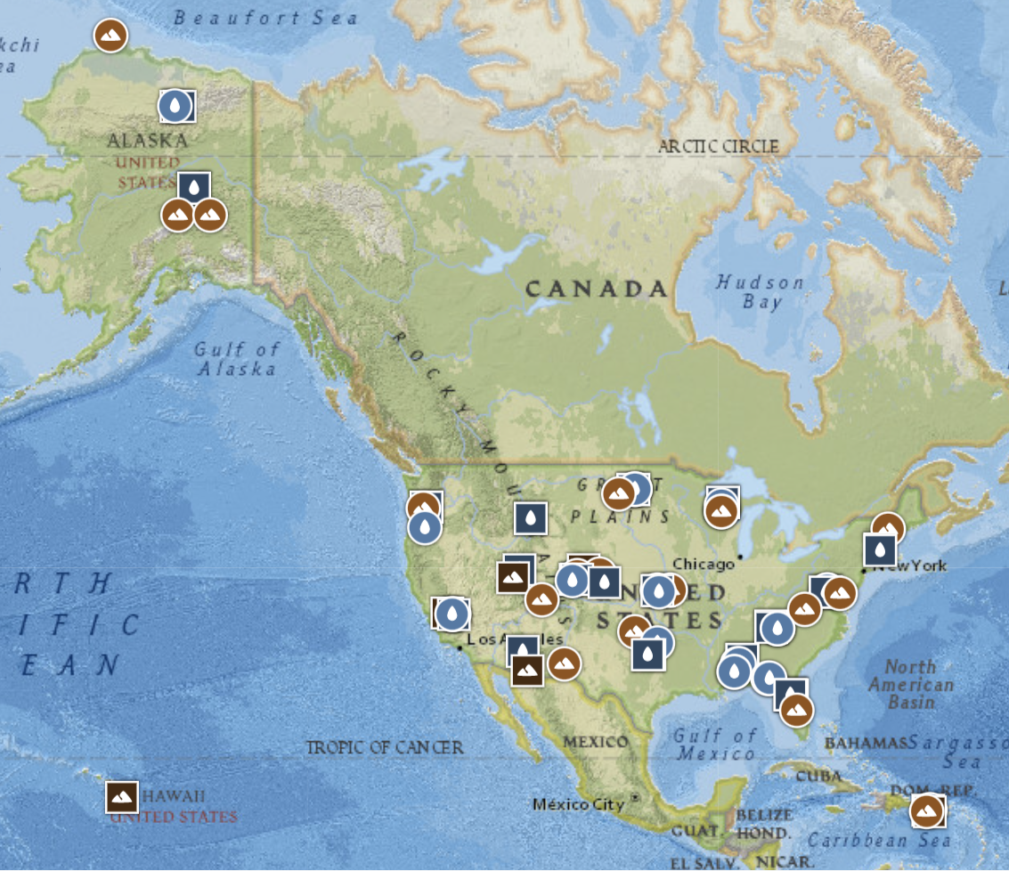
Today…
We are going to generate forecasts of primary productivity in lakes using an ecological model calibrated to real data from the National Ecological Observatory Network (NEON).
NEON is a continental-scale observatory designed to collect long-term open access ecological data to better understand how U.S. terrestrial and aquatic ecosystems are changing
Image: Map of NEON sites, neonscience.org
Notes:
To calibrate our model, we will use data from the U.S. National Science Foundation’s National Ecological Observatory Network, or NEON. NEON is a continental-scale observatory designed to collect long-term open access ecological data to better understand how U.S. terrestrial and aquatic ecosystems are changing. We will be using data from five different lake sites within NEON.

Slide 22
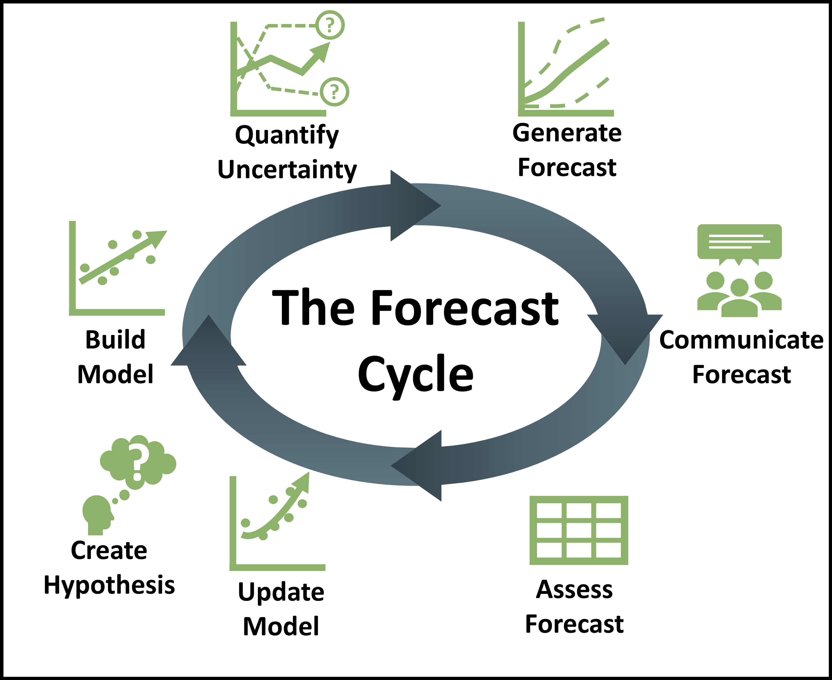
Learning objectives of today’s module:
Describe an ecological forecast and the iterative forecasting cycle
Explore and visualize NEON data
Construct an ecological model to generate forecasts of ecosystem primary productivity with uncertainty
Adjust model parameters and inputs to study how they affect forecast performance relative to observations
Compare productivity forecasts among NEON sites in different climatic regions
Notes:
Learning objectives!
Talk through these with the students one by one: use the embedded animations to sequentially show each of the six bullet points.
Most importantly, the goal here is to have students develop their own ecological model for their aquatic ecosystem, and then step through each stage of the forecast cycle.
At the end of the module, the instructor may request that students make mini-presentations to share their forecast results at the end of Activity C, permitting comparison of primary productivity forecast performance across lakes in different eco-regions.

Slide 23
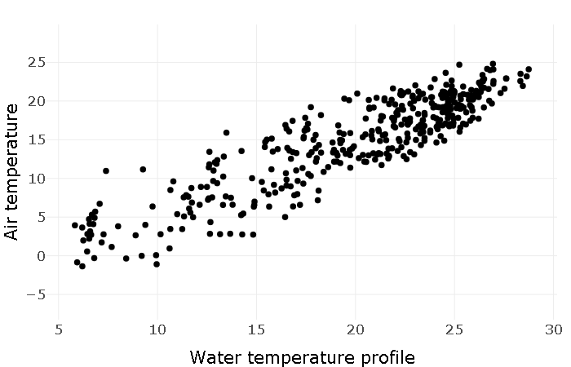
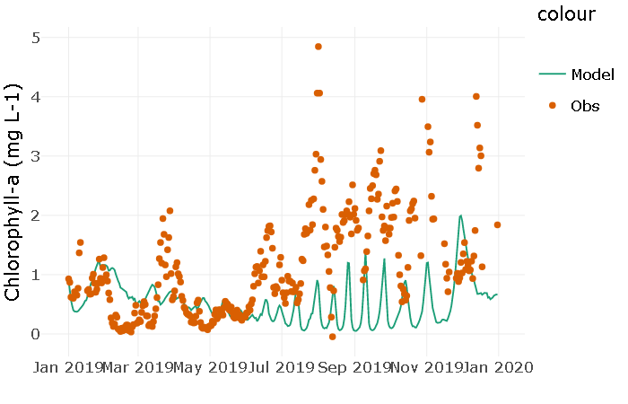
Activity A
With a partner (work in pairs):
Select a NEON site
Visualize the variables at the site
Explore variable relationships
Explore the lake ecosystem model structure
Within pairs, each student builds their own ecosystem model; students then compare the performance of the two different models in predicting productivity at the same lake
Notes:
Introduce Activity A, which has five objectives (have students work in pairs).
Select a NEON site
Visualize the variables at the site
Explore variable relationships
Explore the lake ecosystem model structure
Within pairs, each student builds their own ecosystem model; students then compare the performance of the two different models in predicting productivity at the same lake

Slide 24
Activity B
With a partner (work in pairs):
Quantify forecast uncertainty
Generate a forecast of primary productivity for your site
Communicate forecast
Assess forecast with data
Notes:
Activity B – continue working in pairs and answer the questions individually. Step through each step of the forecast cycle
Quantify forecast uncertainty
Generate a forecast of primary productivity for your site
Communicate forecast
Assess forecast with data

Slide 25
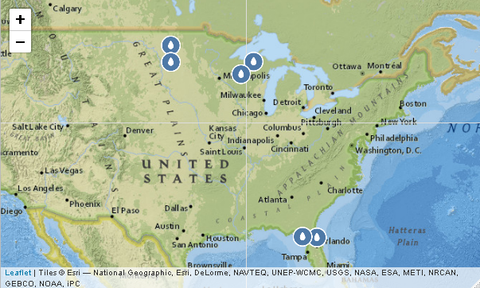
Activity C
With a partner (work in pairs):
Update model to improve forecast
Generate the next forecast
Regroup as a class and compare how your forecasts did over time at different lake sites.
Notes:
Activity C – continue working in pairs. Each student will update their model and generate a new forecast
Update model to improve forecast
Generate the next forecast
At the end of Activity C, regroup as a class and each of the groups present the results from their forecast and how their forecast got better or worse over time

Slide 26

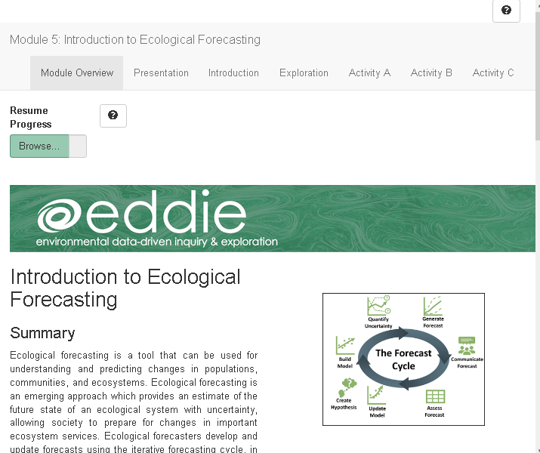
Shiny App
This is an interactive webpage built using R
It has interactive plots and options embedded which allow you to build your own personal model, visualize and explore the data, and answer questions
The module does not require writing any code in R to complete activities!
Notes:
Shiny App:
The module can be accessed as described above via Shiny, GitHub or Binder (see instructor manual)
This is an interactive webpage built using R code
It has interactive plots and options embedded which allow you to build your own personal model, visualize and explore the data, and answer questions

Slide 27
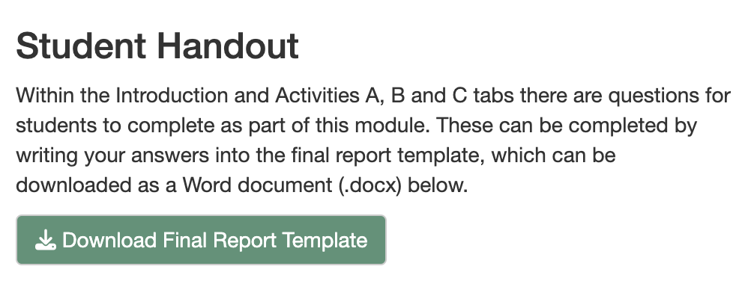
Downloading the Report
Navigate to the “Introduction” tab
Click on the “Download Final Report Template” button to download a Word document into which you can type your answers.
Notes:
Generating the student report. At this point, the instructor may choose to navigate to the Shiny app and demonstrate its features while screen sharing the app in a browser. Alternatively, the instructor may cover the material on slides 27-29 in PowerPoint.

Slide 28
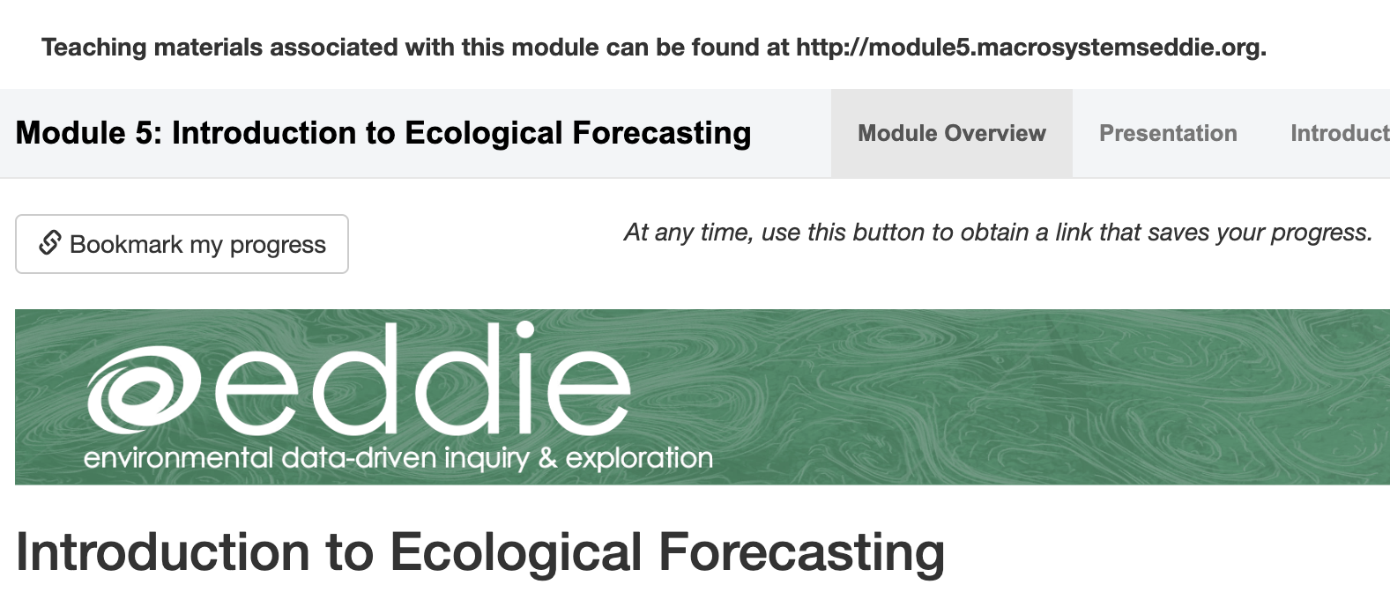
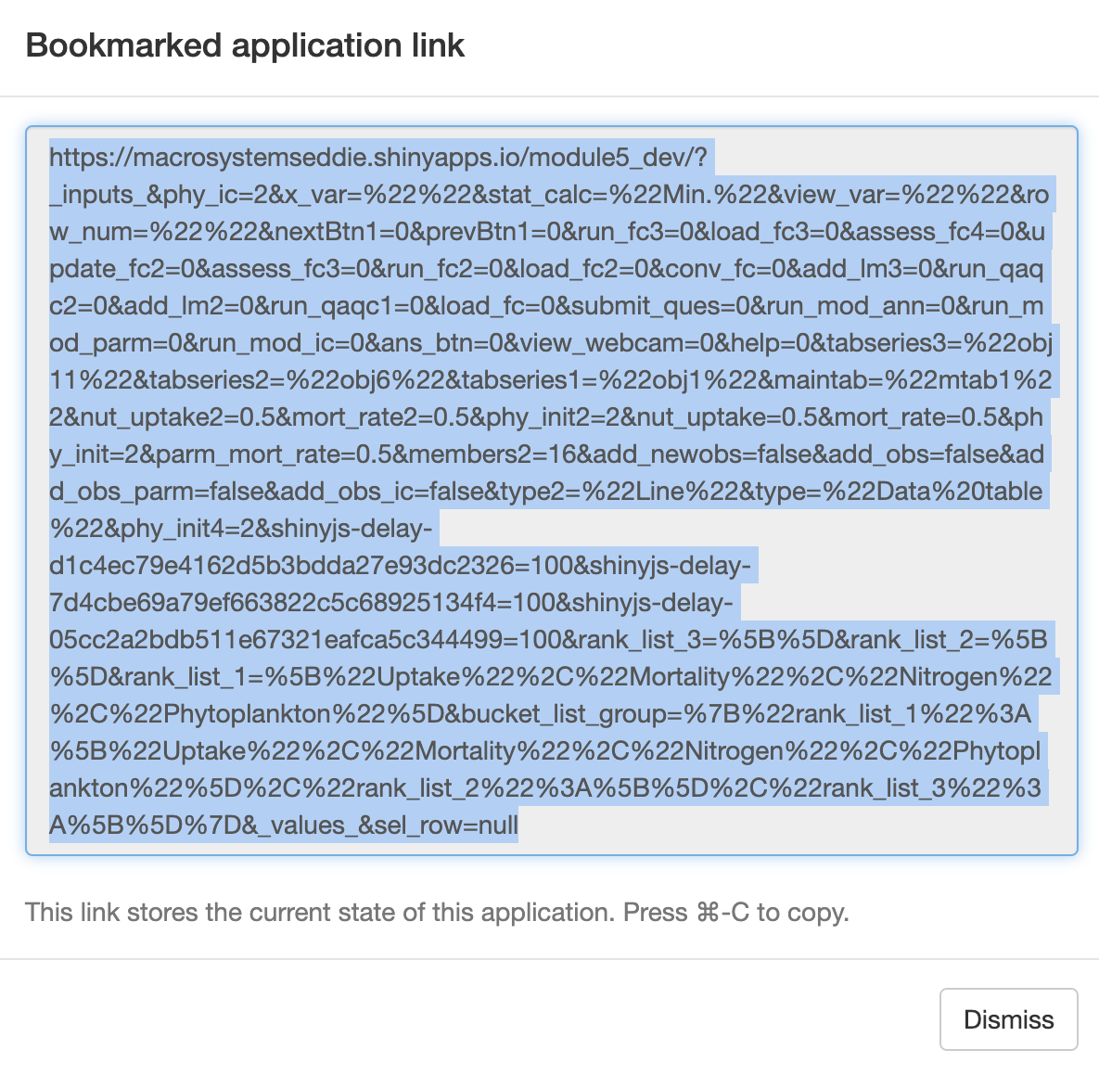
Saving & Resuming Progress
Saving Progress
Scroll to top of the page.
Click on the “Bookmark my progress” button. A pop-up window with a very long link will appear.
Copy-paste the link and store it at the top of your final report.
Resuming progress
Open your browser.
Copy-paste the link into your browser.
As you navigate through the tabs in the module, your progress will reappear.
Notes:
Saving & resuming progress in the Shiny app.

Slide 29
We recommend that you save your progress often!
Because the Shiny app can time out after inactivity (15 minutes) or disconnect if an internet connection is interrupted, we don’t want you to lose your work.
Save your progress as you go, as well as every time you close your computer or close the Shiny app in your internet browser.
After you save the link somewhere safe, you should be able to resume your progress where you left off!
Notes:
We recommend that you save your progress often!

Slide 30
Let’s Go!
For the activity we will work in pairs.
Each pair selects the same NEON site and works through Activities A, B, and C.
It is possible that more than one pair will be assigned to the same lake.
https://macrosystemseddie.shinyapps.io/module5/
Lake name | Students
Crampton Lake
Barco Lake
Prairie Pothole
Little Rock Lake
Prairie Lake
Notes:
Help students transition over to the Shiny app and get started. Instructors may use the table to record which students are working with which lake sites, if helpful.

Slide 31
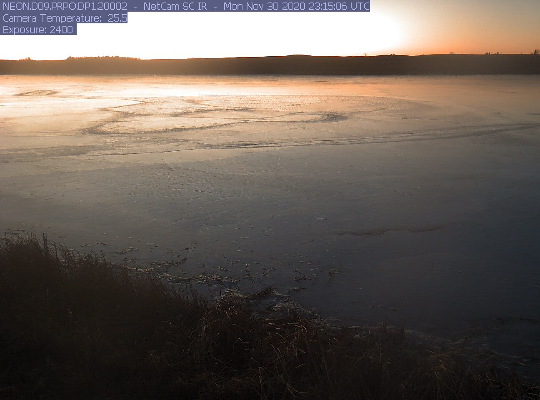
Thank you for participating!
If you’re interested in learning more, check out these modules:
Understanding Uncertainty in Ecological Forecasts
Using Data to Improve Ecological Forecasts
Using Ecological Forecasts to Guide Decision Making
Find out more at: macrosystemsEDDIE.org
Notes:
Thank you for participating! If you would like to learn more, please check out the other Macrosystems EDDIE ecological forecasting modules.

